Slide 1






Air Quality Monitoring and Forecasting System Using Machine Learning
Group_12
1.Aisha
2.Hana Teshome
3.Tewodros Agegnehu
4.Tsion Getu

Slide 2

Outline
Concept note and implementation plan
Background
Objectives
SDG Relation
Data
Data Collection
Exploratory Data Analysis et Feature Engineering
Model
Model Selection and Training
Model Evaluation and Hyperparameter Tuning
Model Refinement and Testing
Results
Evaluation Results
Deployment
Future Work

Slide 3
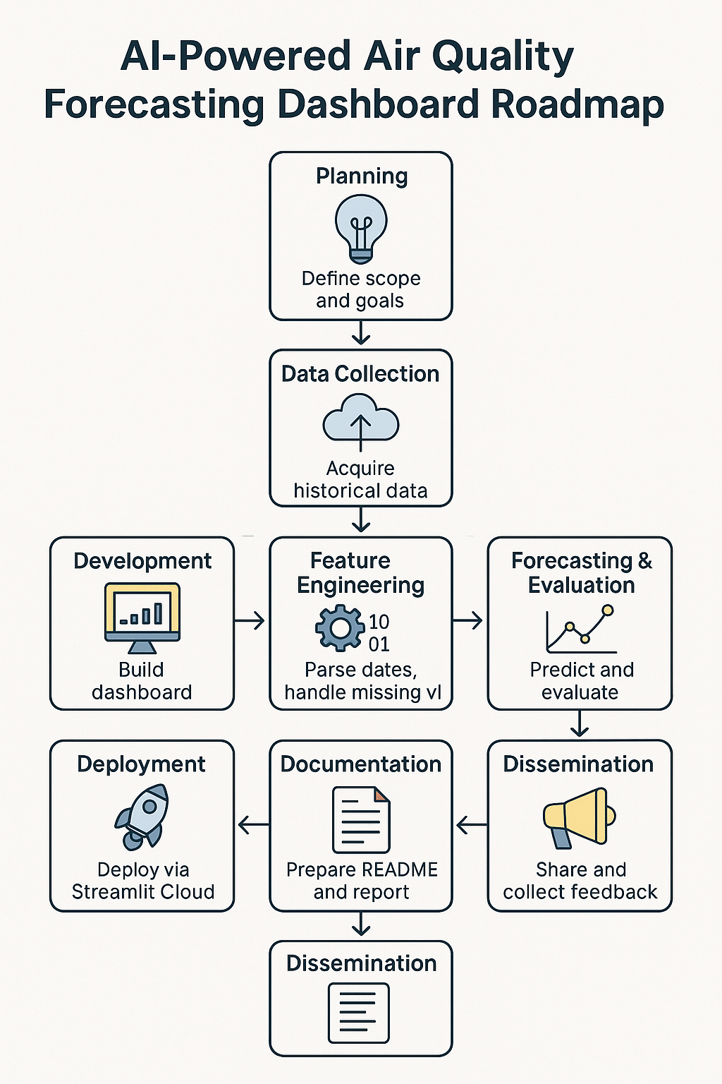
Concept note and Implementation Plan
Notes:
FTs like precision agriculture, remote sensing & AI-powered forming equipment can help increase agricultural productivity in LDCs. This can improve fiid security & contribute to the achievement of SDG 2 (Zero Hunger).

Slide 4
Background
Air pollution poses a significant threat to environmental sustainability and public health worldwide. Rapid urbanization, industrial growth, and increasing vehicle emissions have led to deteriorating air quality in many regions.
Air pollution impact: Air pollution is a critical global issue linked to health problems such as respiratory illnesses, cardiovascular diseases, and increased mortality rates.
Sources of pollution: Major contributors include urbanization, industrial emissions, vehicle exhaust, and energy production, which release harmful pollutants like PM2.5, NO₂, CO, and O₃.
Need for monitoring: Accurate and continuous monitoring of air quality is essential for understanding pollution patterns, implementing regulations, and protecting public health.
Data accessibility challenge: Although air quality data is widely collected, analyzing it often requires technical tools that are not accessible to the general public or small organizations.
Project goal: This project aims to provide a simple, user-friendly dashboard that allows users to upload air quality datasets, visualize trends, and forecast future values.
Value proposition: The dashboard promotes data-driven decision-making, environmental awareness, and broader access to air quality insights through interactive and downloadable reports.
Notes:
FTs like precision agriculture, remote sensing & AI-powered forming equipment can help increase agricultural productivity in LDCs. This can improve fiid security & contribute to the achievement of SDG 2 (Zero Hunger).

Slide 5
Objectives
Enable data upload: Allow users to upload air quality data in CSV format for analysis.
Provide data cleaning and preprocessing: Automatically clean and parse date and numeric columns to ensure accurate analysis.
Support interactive exploration: Enable users to select specific air quality variables and date ranges to explore historical trends.
Visualize air quality trends: Display time-series charts of selected pollutants for clear and informative insights.
Implement forecasting: Use a simple Linear Regression model to predict future values based on historical data.
Offer summary statistics: Provide descriptive statistics for both historical and forecasted data to support interpretation.
Enable data export: Allow users to download forecasted results in CSV format for further analysis or reporting.
Ensure accessibility and ease of use: Design the interface to be intuitive and user-friendly, even for those without technical backgrounds.
Notes:
FTs like precision agriculture, remote sensing & AI-powered forming equipment can help increase agricultural productivity in LDCs. This can improve fiid security & contribute to the achievement of SDG 2 (Zero Hunger).

Slide 6

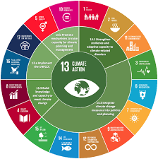
SDG Relation
SDG 3: Good Health and Well-BeingSDG 3: Good Health and Well-Being
The app helps monitor and forecast air pollution, which is a major risk factor for respiratory and cardiovascular diseases. By enabling early insights into pollution levels, the tool supports initiatives aimed at reducing health risks and promoting well-being.
SDG 13: Climate Action
Although focused on air quality, the project supports climate action indirectly by encouraging environmental monitoring and awareness. Data-driven insights can inform policies that reduce emissions and mitigate the effects of climate change.
Notes:
FTs like precision agriculture, remote sensing & AI-powered forming equipment can help increase agricultural productivity in LDCs. This can improve fiid security & contribute to the achievement of SDG 2 (Zero Hunger).

Slide 7
Data
Data Source:
The dashboard accepts air quality data uploaded by users in CSV format. This allows flexibility to analyze data from various sources, including local environmental agencies, open government datasets, academic research, or sensor networks.
Output:
Historical and forecasted values are visualized as a continuous time series.
Forecasted results can be downloaded as a CSV file.
Summary statistics are provided for the forecasted period (mean, std, min, max, quartiles).
Notes:
FTs like precision agriculture, remote sensing & AI-powered forming equipment can help increase agricultural productivity in LDCs. This can improve fiid security & contribute to the achievement of SDG 2 (Zero Hunger).

Slide 8
Data Collection
Sensor AAU 4K, Addis Ababa, Ethiopia (Purple Air/93739)
# https://aqicn.org/station/@218920/ Real-time Air Quality Index (AQI) ensor AAU 4K (Purple Air 93739) in Addis Ababa, Ethiopia is a low-cost, Wi‑Fi–enabled air quality monitor located at the Addis Ababa University College of Natural Sciences (King George VI Avenue, Arat Kilo).
The sensor’s data is publicly accessible through the AQICN platform and the WAQI API, making it a valuable resource for real-time air quality insights, environmental awareness, and academic research.
Notes:
FTs like precision agriculture, remote sensing & AI-powered forming equipment can help increase agricultural productivity in LDCs. This can improve fiid security & contribute to the achievement of SDG 2 (Zero Hunger).

Slide 9
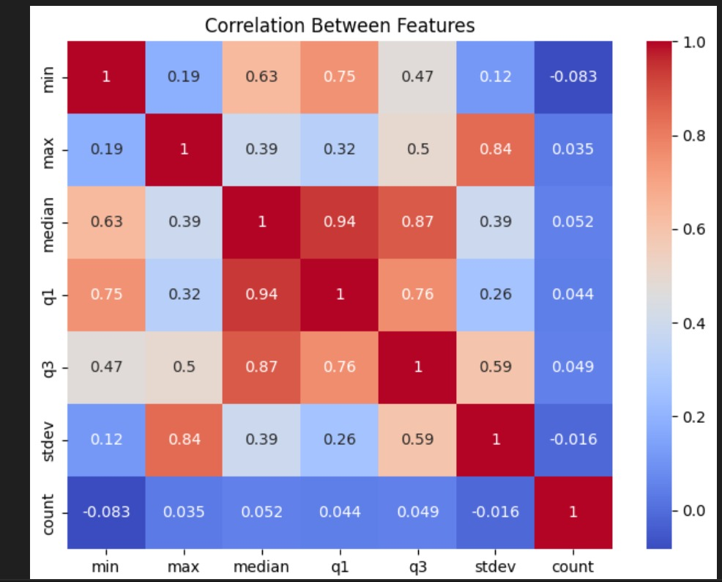
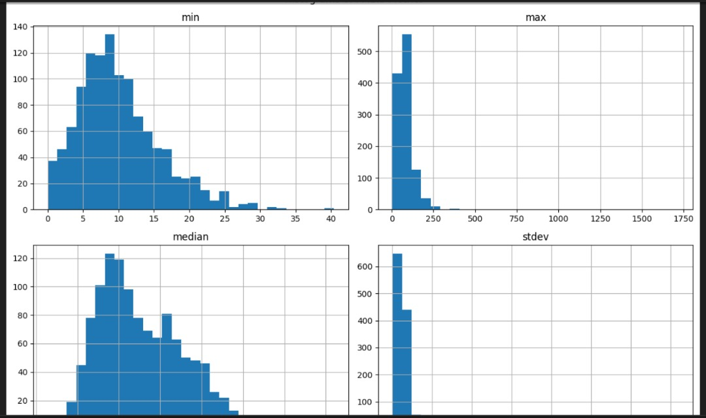
Exploratory Data Analysis and Feature Engineering
Correlation Between Features
Distributions of Pollutants
Notes:
FTs like precision agriculture, remote sensing & AI-powered forming equipment can help increase agricultural productivity in LDCs. This can improve fiid security & contribute to the achievement of SDG 2 (Zero Hunger).

Slide 10
Model
The project utilizes Linear Regressionand Random forest model to forecast future air quality values based on historical trends. This approach is chosen for its transparency, ease of interpretation, and suitability for baseline forecasting.
Notes:
FTs like precision agriculture, remote sensing & AI-powered forming equipment can help increase agricultural productivity in LDCs. This can improve fiid security & contribute to the achievement of SDG 2 (Zero Hunger).

Slide 11
Model Selection and Training
Model Selection
A Linear Regression model and Random Forest was selected as the initial forecasting algorithm due to its simplicity, interpretability, and efficiency for time-based trend prediction. It serves as a strong baseline for modeling continuous environmental variables like PM2.5, PM10, or other air quality indicators.
Rationale for Selection:
Low computational cost, making it ideal for real-time web apps like Streamlit.
Provides an interpretable slope and intercept to understand pollution trends.
Performs reasonably well when air quality shows consistent linear behavior over time.
Training Process:
1.Data Preprocessing:The selected variable is cleaned of missing values.
A new column, day_index, is created to numerically represent each day in the dataset.
2.Model Fitting:The model is trained using day_index as the independent variable (X) and the selected air quality metric as the dependent
variable (y).
3.Prediction:Based on the last index in the dataset, new day_index values are generated for future days (up to 90 days as selected by the user).
Notes:
FTs like precision agriculture, remote sensing & AI-powered forming equipment can help increase agricultural productivity in LDCs. This can improve fiid security & contribute to the achievement of SDG 2 (Zero Hunger).

Slide 12
Model Evaluation and Hyperparameter Tuning
Random Forest Metrics:
MAE: 0.18059202714287864, RMSE: 0.3174026635415839, R²: 0.8605930956499708
7/7 ━━━━━━━━━━━━━━━━━━━━ 0s 34ms/step
LSTM Metrics:
MAE: 0.5809781066200294, RMSE: 0.8003778025211229, R²: 0.08983593158896575
Notes:
FTs like precision agriculture, remote sensing & AI-powered forming equipment can help increase agricultural productivity in LDCs. This can improve fiid security & contribute to the achievement of SDG 2 (Zero Hunger).

Slide 13
Model Refinement and Testing
After training the initial Linear Regression model, refinement was carried out to improve accuracy and reliability. The dataset was split into training and testing subsets (typically using an 80/20 ratio) to ensure the model's performance could be fairly assessed on unseen data. Various preprocessing steps were refined, including removing outliers, handling missing values, and optimizing the forecast window. The model was then tested using key performance metrics such as Mean Absolute Error (MAE), Root Mean Squared Error (RMSE), and R² Score to quantify its predictive power.
Notes:
FTs like precision agriculture, remote sensing & AI-powered forming equipment can help increase agricultural productivity in LDCs. This can improve fiid security & contribute to the achievement of SDG 2 (Zero Hunger).

Slide 14
Results
The project successfully developed an interactive dashboard that allows users to upload air quality data, explore historical trends, and generate future forecasts using a Linear Regression model. Key results include:
Data Exploration:
The dashboard enables clear visualization of air quality metrics over selected date ranges, helping identify trends, seasonal patterns, and anomalies in pollutant levels.
Forecasting Accuracy:
The Linear Regression model provided reasonable short-term forecasts (e.g., up to 30 days), capturing general trends in air quality data with acceptable error margins. Evaluation metrics such as Mean Absolute Error (MAE) and R-squared (R²) demonstrated the model’s ability to predict future values based on historical trends.
User Interactivity:
Users can easily select the variable to analyze, filter date ranges, choose forecast horizons, and download forecasted data for further analysis or reporting.
Notes:
FTs like precision agriculture, remote sensing & AI-powered forming equipment can help increase agricultural productivity in LDCs. This can improve fiid security & contribute to the achievement of SDG 2 (Zero Hunger).

Slide 15
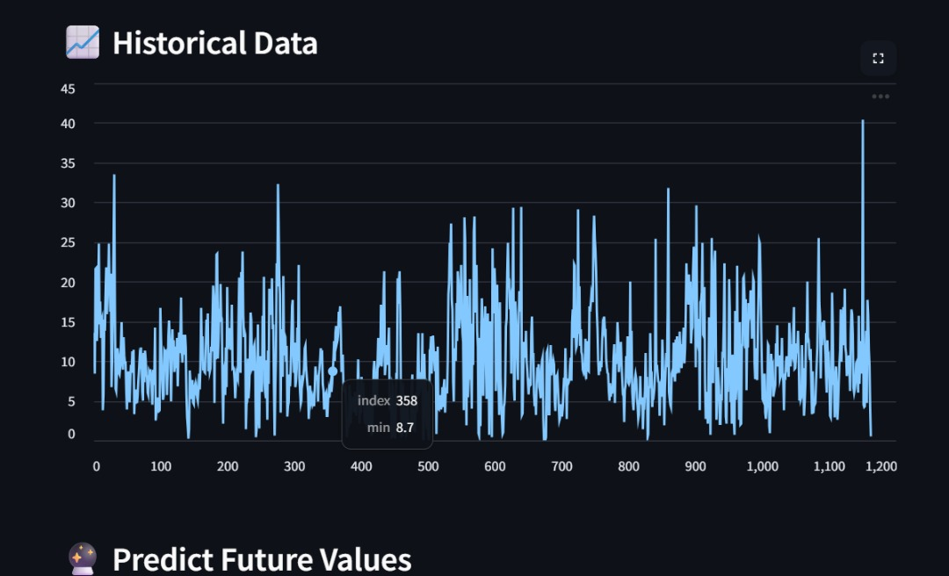
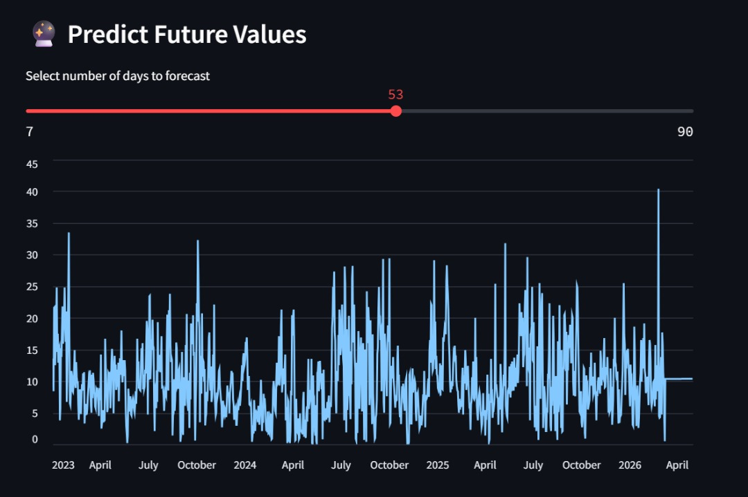
Evaluation Results
Evaluation ResultsThe performance of the Linear Regression forecasting model was evaluated using standard metrics on a held-out test set of air quality data. The key findings include:
accuracy:78.8%
Notes:
FTs like precision agriculture, remote sensing & AI-powered forming equipment can help increase agricultural productivity in LDCs. This can improve fiid security & contribute to the achievement of SDG 2 (Zero Hunger).

Slide 16
Deployment
The air quality forecasting application was deployed using Streamlit, a Python-based framework that allows rapid development and sharing of interactive data apps. The key deployment steps included:
Requirements Management:
A requirements.txt file was used to specify all Python dependencies, ensuring consistent environments across development and deployment.
App Development:
The dashboard was built using Streamlit with core libraries like pandas, scikit-learn, and matplotlib, enabling data upload, exploration, and forecasting.
Notes:
FTs like precision agriculture, remote sensing & AI-powered forming equipment can help increase agricultural productivity in LDCs. This can improve fiid security & contribute to the achievement of SDG 2 (Zero Hunger).

Slide 17
Future Work
To enhance the accuracy and usability of the air quality forecasting system, several improvements and extensions can be pursued:
Advanced Modeling Techniques:Explore more sophisticated time series models such as ARIMA, Prophet, or machine learning methods like Random Forests and LSTM neural networks that can better capture nonlinearities, seasonality.
Feature Enrichment:Incorporate additional relevant variables like meteorological data (temperature, humidity, wind speed), traffic volume, or industrial activity to improve model explanatory power and forecast accuracy.
Real-Time Data Integration:Connect the app with live air quality sensors or public APIs to provide up-to-date forecasts and alerts.
Model Explainability: Integrate explainable AI techniques to help users understand model predictions and contributing factors.
Notes:
FTs like precision agriculture, remote sensing & AI-powered forming equipment can help increase agricultural productivity in LDCs. This can improve fiid security & contribute to the achievement of SDG 2 (Zero Hunger).

Slide 18
References
PurpleAir – Real-Time Air Quality Monitoring
Sensor AAU 4K, Addis Ababa, Ethiopia
Pedregosa et al. (2011)
Scikit-learn: Machine Learning in Python
Journal of Machine Learning Research, 12, 2825–2830.
Pandas Documentation
https://pandas.pydata.org/docs/
Streamlit Documentation
https://docs.streamlit.io/
UN Sustainable Development Goals (SDGs)
Notes:
FTs like precision agriculture, remote sensing & AI-powered forming equipment can help increase agricultural productivity in LDCs. This can improve fiid security & contribute to the achievement of SDG 2 (Zero Hunger).

Slide 19


Thank you!

